Slide 1
A Gentle Introduction to Linear Algebra
Prasanna Date
Research Scientist
Computer Science & Mathematics
Oak Ridge National Laboratory
USA
→ datepa@ornl.gov |  @PrasannaDate | ✶ PrasannaDate.com |  @PrasannaDate

Slide 2
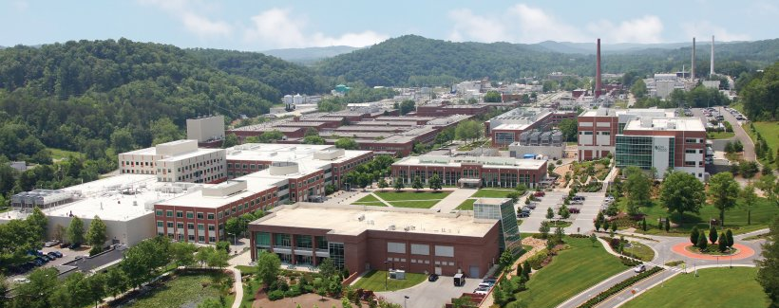
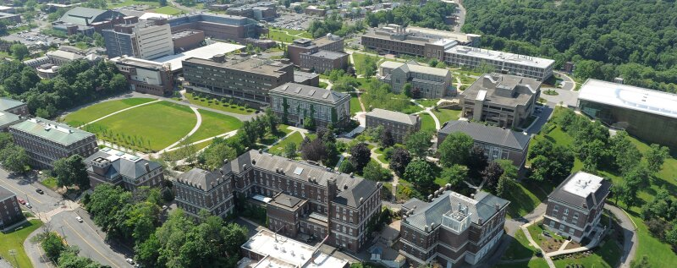

Background
Oak Ridge National Laboratory (ORNL), Tennessee, USA
Experience
Research Scientist at ORNL (2019)
Education
PhD, MS and MEng from RPI (2019)
BE (Honors) from BITS Pilani (2014)
Research Interests: Quantum AI, Neuromorphic AI
Service:
Associate Editor, IEEE TNNLS
Editorial Board Member, Nature Scientific Reports and Frontiers in Systems Neuroscience
Reviewer for ICML, Nature Communications Physics, Physical Review A, PLOS One etc.
Rensselaer Polytechnic Institute (RPI), New York, USA
Birla Institute of Technology & Science (BITS) Pilani, Rajasthan, India

Slide 3
What is Linear Algebra?
Technical Definition: A branch of mathematics that deals with mathematical structures closed under the operations of addition and scalar multiplication and that includes the theory of systems of linear equations, matrices, determinants, vector spaces, and linear transformations

Slide 4
What is Linear Algebra?
Technical Definition: A branch of mathematics that deals with mathematical structures closed under the operations of addition and scalar multiplication and that includes the theory of systems of linear equations, matrices, determinants, vector spaces, and linear transformations
Simple Definition: Mathematics of linear systems of any kind

Slide 5
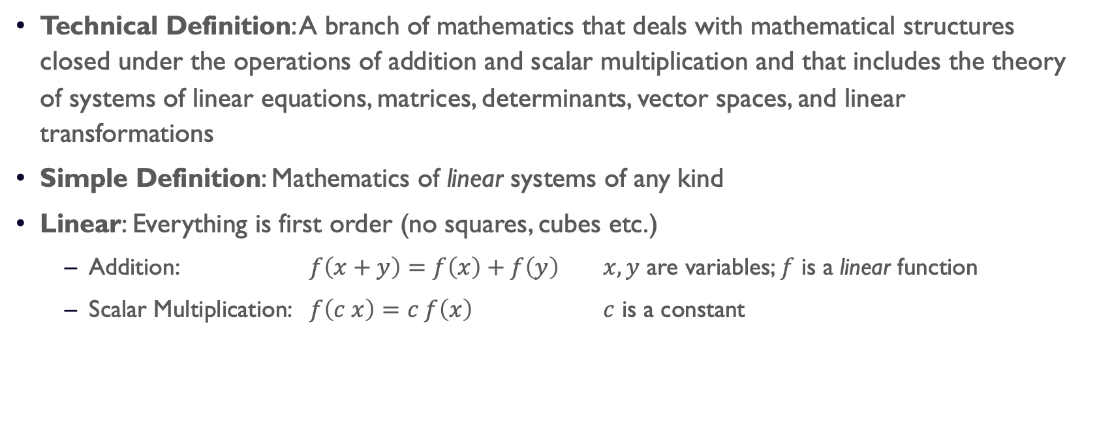
What is Linear Algebra?
Technical Definition: A branch of mathematics that deals with mathematical structures closed under the operations of addition and scalar multiplication and that includes the theory of systems of linear equations, matrices, determinants, vector spaces, and linear transformations
Simple Definition: Mathematics of linear systems of any kind
Linear: Everything is first order (no squares, cubes etc.)
Addition: $f\left(x+y\right)=f\left(x\right)+f\left(y\right)$ $x,y$ are variables; $f$ is a linear function
Scalar Multiplication: $f\left(c x\right)=c f\left(x\right)$ $c$ is a constant

Slide 6
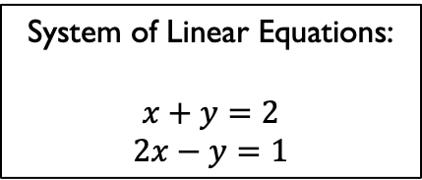
What is Linear Algebra?
Technical Definition: A branch of mathematics that deals with mathematical structures closed under the operations of addition and scalar multiplication and that includes the theory of systems of linear equations, matrices, determinants, vector spaces, and linear transformations
Simple Definition: Mathematics of linear systems of any kind
Linear: Everything is first order (no squares, cubes etc.)
Addition: $f\left(x+y\right)=f\left(x\right)+f\left(y\right)$ $x,y$ are variables; $f$ is a linear function
Scalar Multiplication: $f\left(c x\right)=c f\left(x\right)$ $c$ is a constant
System of Linear Equations:
$$x+y=2$$
$$2x−y=1$$

Slide 7
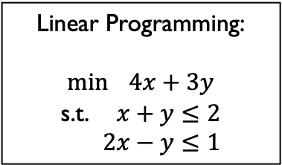
What is Linear Algebra?
Technical Definition: A branch of mathematics that deals with mathematical structures closed under the operations of addition and scalar multiplication and that includes the theory of systems of linear equations, matrices, determinants, vector spaces, and linear transformations
Simple Definition: Mathematics of linear systems of any kind
Linear: Everything is first order (no squares, cubes etc.)
Addition: $f\left(x+y\right)=f\left(x\right)+f\left(y\right)$ $x,y$ are variables; $f$ is a linear function
Scalar Multiplication: $f\left(c x\right)=c f\left(x\right)$ $c$ is a constant
System of Linear Equations:
$$x+y=2$$
$$2x−y=1$$
Linear Programming:
$$\min{ 4x+3y}$$
s.t. $x+y≤2$
$2x−y≤1$

Slide 8
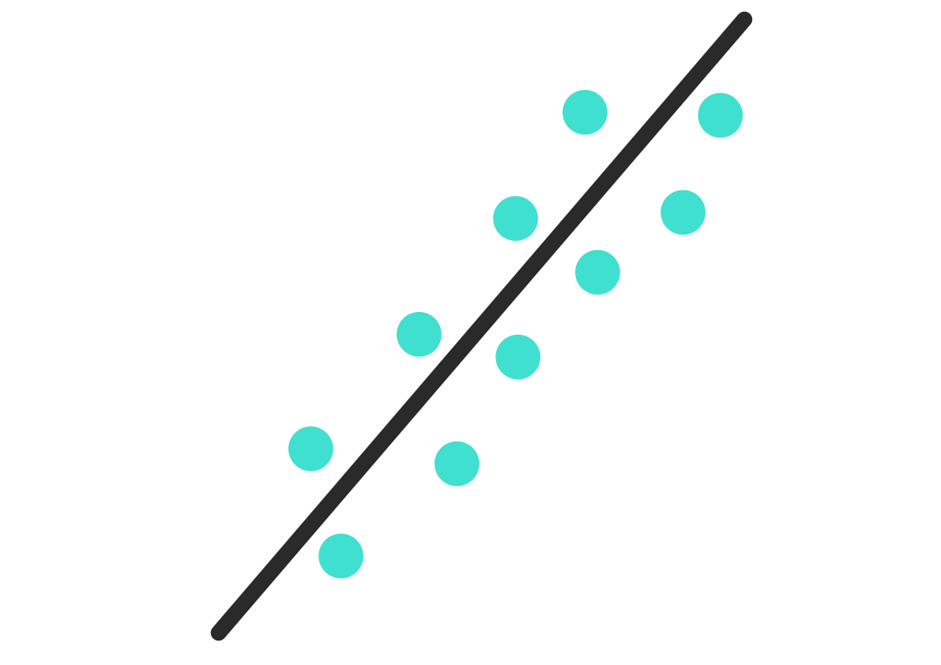
What is Linear Algebra?
Technical Definition: A branch of mathematics that deals with mathematical structures closed under the operations of addition and scalar multiplication and that includes the theory of systems of linear equations, matrices, determinants, vector spaces, and linear transformations
Simple Definition: Mathematics of linear systems of any kind
Linear: Everything is first order (no squares, cubes etc.)
Addition: $f\left(x+y\right)=f\left(x\right)+f\left(y\right)$ $x,y$ are variables; $f$ is a linear function
Scalar Multiplication: $f\left(c x\right)=c f\left(x\right)$ $c$ is a constant
Linear Programming:
$$\min{ 4x+3y}$$
s.t. $x+y≤2$
$2x−y≤1$
Linear Regression:
System of Linear Equations:
$$x+y=2$$
$$2x−y=1$$

Slide 9

What is Linear Algebra?
Technical Definition: A branch of mathematics that deals with mathematical structures closed under the operations of addition and scalar multiplication and that includes the theory of systems of linear equations, matrices, determinants, vector spaces, and linear transformations
Simple Definition: Mathematics of linear systems of any kind
Linear: Everything is first order (no squares, cubes etc.)
Addition: $f\left(x+y\right)=f\left(x\right)+f\left(y\right)$ $x,y$ are variables; $f$ is a linear function
Scalar Multiplication: $f\left(c x\right)=c f\left(x\right)$ $c$ is a constant
Linear Programming:
$$\min{ 4x+3y}$$
s.t. $x+y≤2$
$2x−y≤1$
Linear Regression:
Linear Classification:
System of Linear Equations:
$$x+y=2$$
$$2x−y=1$$

Slide 10
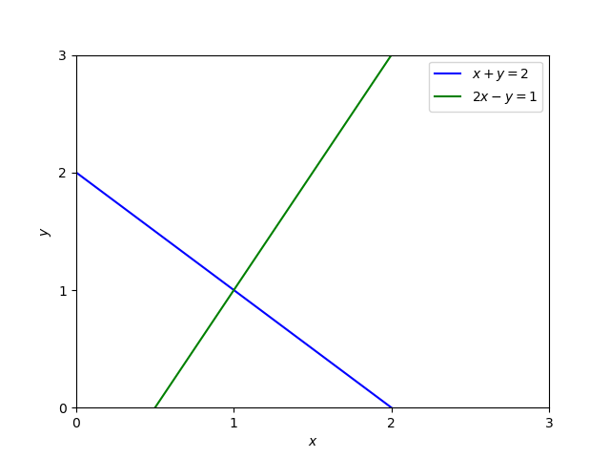
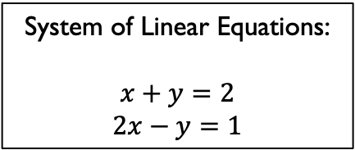
What do linear systems look like?
System of Linear Equations:
$$x+y=2$$
$$2x−y=1$$

Slide 11
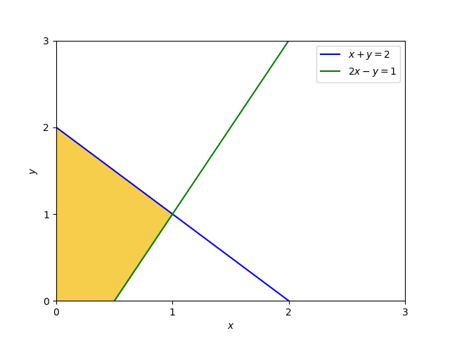
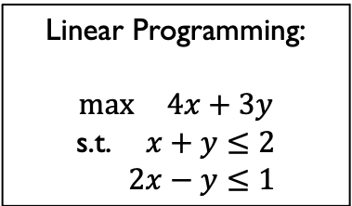
What do linear systems look like?
System of Linear Equations:
$$x+y=2$$
$$2x−y=1$$
Linear Programming:
$$\max{ 4x+3y}$$
s.t. $x+y≤2$
$2x−y≤1$

Slide 12
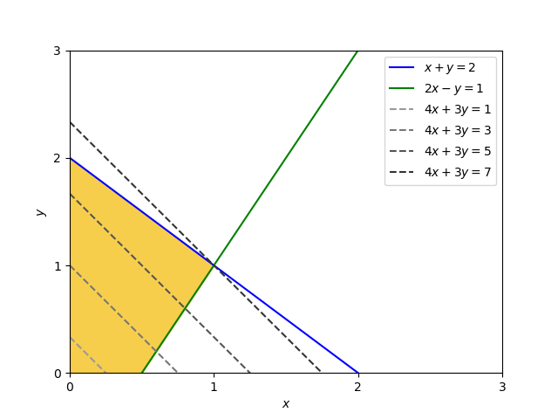
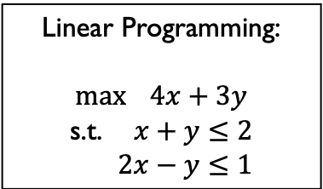
What do linear systems look like?
System of Linear Equations:
$$x+y=2$$
$$2x−y=1$$
Linear Programming:
$$\max{ 4x+3y}$$
s.t. $x+y≤2$
$2x−y≤1$

Slide 13
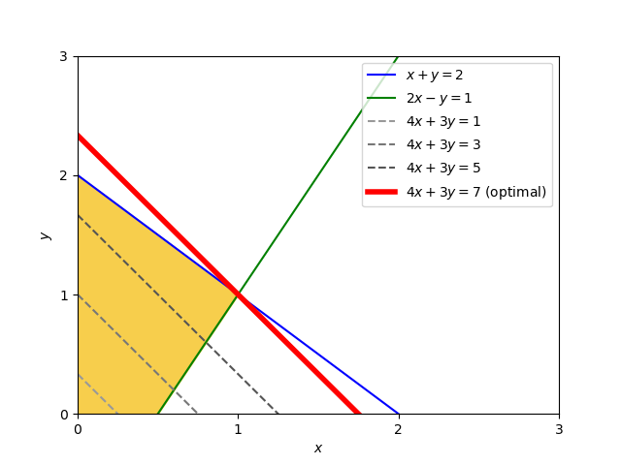
What do linear systems look like?
System of Linear Equations:
$$x+y=2$$
$$2x−y=1$$
Linear Programming:
$$\max{ 4x+3y}$$
s.t. $x+y≤2$
$2x−y≤1$

Slide 14
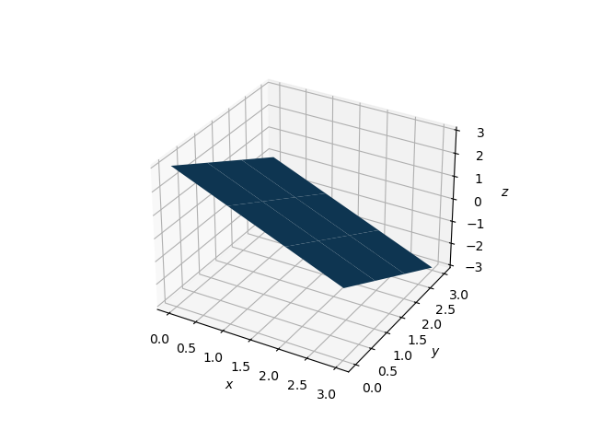
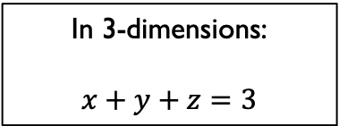
What do linear systems look like?
System of Linear Equations:
$$x+y=2$$
$$2x−y=1$$
Linear Programming:
$$\max{ 4x+3y}$$
s.t. $x+y≤2$
$2x−y≤1$
In 3-dimensions:
$$x+y+z=3$$

Slide 15
Why Linear Algebra?
Data of any kind (images, video, text, numeric, multi-modal) is usually represented as vectors, matrices or tensors
Linear Algebra deals with matrix and vector operations
Knowledge about manipulating vectors, matrices and tensors enables us to analyze the data effectively – faster, scalable, more accurate, less compute resources, high elegance etc.
Wide range of applications
AI, machine learning, deep learning, data science
Modeling and simulation: supply chain, social networks, economics and finance
Optimization
Image and video processing
Quantum computing

Slide 16
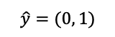
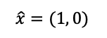


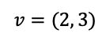
Vectors
Mathematical objects having magnitude as well as direction
$$y$$
$$v=(2, 3)$$
$$v=\left[\begin{matrix}2 \\ 3\end{matrix}\right]$$
$$\hat{y}=(0, 1)$$
$$\hat{x}=(1, 0)$$
$$x$$

Slide 17
Vectors
Mathematical objects having magnitude as well as direction
$$y$$
$$v=(2, 3)$$
$$v=\left[\begin{matrix}2 \\ 3\end{matrix}\right]$$
Standard Basis
$$v=2\left[\begin{matrix}1 \\ 0\end{matrix}\right]+3\left[\begin{matrix}0 \\ 1\end{matrix}\right]$$
$$v=2\hat{x}+3\hat{y}$$
$$\hat{y}=(0, 1)$$
$$\hat{x}=(1, 0)$$
$$x$$

Slide 18
Matrices
Vectors stacked horizontally; captures linear operations.
$$y$$
$$v=(2, 3)$$
$$v=\left[\begin{matrix}2 \\ 3\end{matrix}\right]$$
$$v=2\left[\begin{matrix}1 \\ 0\end{matrix}\right]+3\left[\begin{matrix}0 \\ 1\end{matrix}\right]$$
Standard basis vectors stacked horizontally
$$v=2\hat{x}+3\hat{y}$$
$$v=\left[\begin{matrix}\hat{x} & \hat{y}\end{matrix}\right]\left[\begin{matrix}2 \\ 3\end{matrix}\right]$$
$$\hat{y}=(0, 1)$$
$$\hat{x}=(1, 0)$$
$$x$$

Slide 19
Matrices
Vectors stacked horizontally; captures linear operations.
$$y$$
$$v=(2, 3)$$
$$v=\left[\begin{matrix}2 \\ 3\end{matrix}\right]$$
$$v=2\left[\begin{matrix}1 \\ 0\end{matrix}\right]+3\left[\begin{matrix}0 \\ 1\end{matrix}\right]$$
Standard basis vectors stacked horizontally
$$v=2\hat{x}+3\hat{y}$$
$$v=\left[\begin{matrix}\hat{x} & \hat{y}\end{matrix}\right]\left[\begin{matrix}2 \\ 3\end{matrix}\right]$$
$$\hat{y}=(0, 1)$$
$$v=\left[\begin{matrix}\begin{matrix}1 \\ 0\end{matrix} & \begin{matrix}0 \\ 1\end{matrix}\end{matrix}\right]\left[\begin{matrix}2 \\ 3\end{matrix}\right]$$
$$\hat{x}=(1, 0)$$
$$x$$

Slide 20
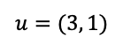
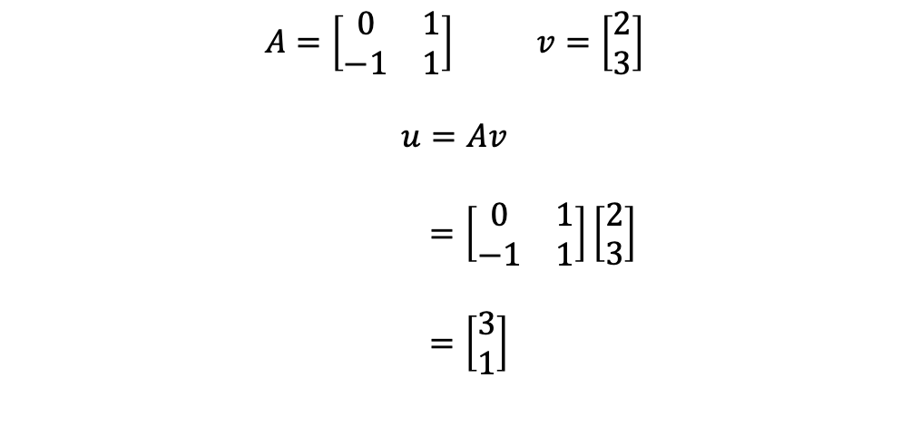
Matrices
$$y$$
$A=\left[\begin{matrix}0 & 1 \\ −1 & 1\end{matrix}\right]$ $v=\left[\begin{matrix}2 \\ 3\end{matrix}\right]$
$$u=Av$$
$=\left[\begin{matrix}\begin{matrix}0 \\ −1\end{matrix} & \begin{matrix}1 \\ 1\end{matrix}\end{matrix}\right]\left[\begin{matrix}2 \\ 3\end{matrix}\right]$
$=\left[\begin{matrix}3 \\ 1\end{matrix}\right]$
$$v=(2, 3)$$
$$\hat{y}=(0, 1)$$
$$u=(3, 1)$$
$$\hat{x}=(1, 0)$$
$$x$$

Slide 21
Types of Matrices
Square
Rectangular
Diagonal
Identity
Lower Triangular
Upper Triangular
Symmetric
Skew Symmetric
Singular
Non-Singular

Slide 22
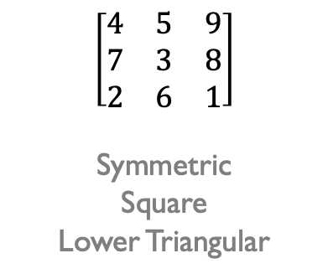
What Type of Matrix is This?
$$\left[\begin{matrix}4 & 5 & 9 \\ 7 & 3 & 8 \\ 2 & 6 & 1\end{matrix}\right]$$
Symmetric
Square
Lower Triangular

Slide 23

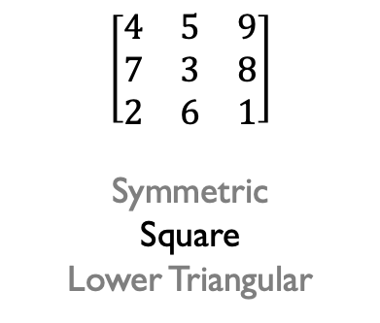
What Type of Matrix is This?
$$\left[\begin{matrix}4 & 5 & 9 \\ 7 & 3 & 8 \\ 2 & 6 & 1\end{matrix}\right]$$
Symmetric
Square
Lower Triangular

Slide 24
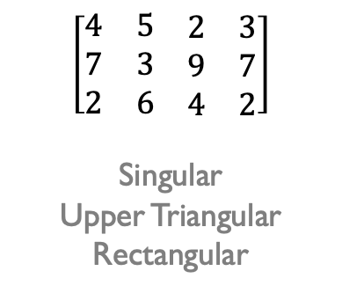
What Type of Matrix is This?
$$\left[\begin{matrix}4 & 5 & 9 \\ 7 & 3 & 8 \\ 2 & 6 & 1\end{matrix}\right]$$
Symmetric
Square
Lower Triangular
$$\left[\begin{matrix}4 & 5 & \begin{matrix}2 & 3\end{matrix} \\ 7 & 3 & \begin{matrix}9 & 7\end{matrix} \\ 2 & 6 & \begin{matrix}4 & 2\end{matrix}\end{matrix}\right]$$
Singular
Upper Triangular
Rectangular

Slide 25
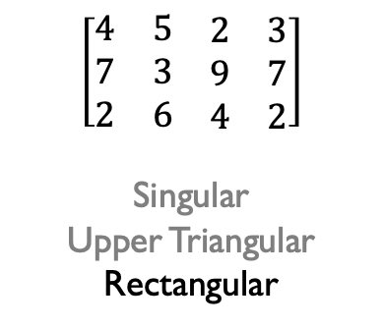
What Type of Matrix is This?
$$\left[\begin{matrix}4 & 5 & 9 \\ 7 & 3 & 8 \\ 2 & 6 & 1\end{matrix}\right]$$
Symmetric
Square
Lower Triangular
$$\left[\begin{matrix}4 & 5 & \begin{matrix}2 & 3\end{matrix} \\ 7 & 3 & \begin{matrix}9 & 7\end{matrix} \\ 2 & 6 & \begin{matrix}4 & 2\end{matrix}\end{matrix}\right]$$
Singular
Upper Triangular
Rectangular

Slide 26
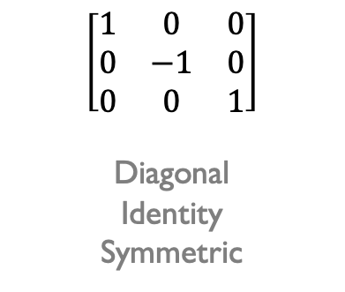
What Type of Matrix is This?
$$\left[\begin{matrix}4 & 5 & 9 \\ 7 & 3 & 8 \\ 2 & 6 & 1\end{matrix}\right]$$
Symmetric
Square
Lower Triangular
$$\left[\begin{matrix}4 & 5 & \begin{matrix}2 & 3\end{matrix} \\ 7 & 3 & \begin{matrix}9 & 7\end{matrix} \\ 2 & 6 & \begin{matrix}4 & 2\end{matrix}\end{matrix}\right]$$
Singular
Upper Triangular
Rectangular
$$\left[\begin{matrix}1 & 0 & 0 \\ 0 & −1 & 0 \\ 0 & 0 & 1\end{matrix}\right]$$
Diagonal
Identity
Symmetric

Slide 27
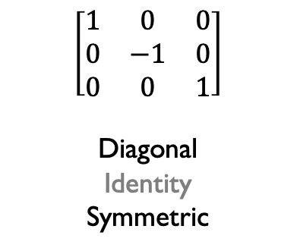
What Type of Matrix is This?
$$\left[\begin{matrix}4 & 5 & 9 \\ 7 & 3 & 8 \\ 2 & 6 & 1\end{matrix}\right]$$
Symmetric
Square
Lower Triangular
$$\left[\begin{matrix}4 & 5 & \begin{matrix}2 & 3\end{matrix} \\ 7 & 3 & \begin{matrix}9 & 7\end{matrix} \\ 2 & 6 & \begin{matrix}4 & 2\end{matrix}\end{matrix}\right]$$
Singular
Upper Triangular
Rectangular
$$\left[\begin{matrix}1 & 0 & 0 \\ 0 & −1 & 0 \\ 0 & 0 & 1\end{matrix}\right]$$
Diagonal
Identity
Symmetric

Slide 28
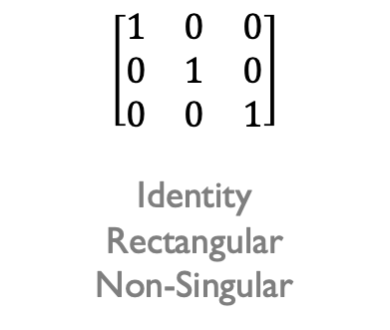
What Type of Matrix is This?
$$\left[\begin{matrix}4 & 5 & 9 \\ 7 & 3 & 8 \\ 2 & 6 & 1\end{matrix}\right]$$
Symmetric
Square
Lower Triangular
$$\left[\begin{matrix}4 & 5 & \begin{matrix}2 & 3\end{matrix} \\ 7 & 3 & \begin{matrix}9 & 7\end{matrix} \\ 2 & 6 & \begin{matrix}4 & 2\end{matrix}\end{matrix}\right]$$
Singular
Upper Triangular
Rectangular
$$\left[\begin{matrix}1 & 0 & 0 \\ 0 & −1 & 0 \\ 0 & 0 & 1\end{matrix}\right]$$
Diagonal
Identity
Symmetric
$$\left[\begin{matrix}1 & 0 & 0 \\ 0 & 1 & 0 \\ 0 & 0 & 1\end{matrix}\right]$$
Identity
Rectangular
Non-Singular

Slide 29
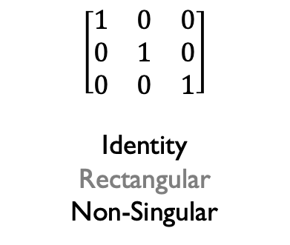
What Type of Matrix is This?
$$\left[\begin{matrix}4 & 5 & 9 \\ 7 & 3 & 8 \\ 2 & 6 & 1\end{matrix}\right]$$
Symmetric
Square
Lower Triangular
$$\left[\begin{matrix}4 & 5 & \begin{matrix}2 & 3\end{matrix} \\ 7 & 3 & \begin{matrix}9 & 7\end{matrix} \\ 2 & 6 & \begin{matrix}4 & 2\end{matrix}\end{matrix}\right]$$
Singular
Upper Triangular
Rectangular
$$\left[\begin{matrix}1 & 0 & 0 \\ 0 & −1 & 0 \\ 0 & 0 & 1\end{matrix}\right]$$
Diagonal
Identity
Symmetric
$$\left[\begin{matrix}1 & 0 & 0 \\ 0 & 1 & 0 \\ 0 & 0 & 1\end{matrix}\right]$$
Identity
Rectangular
Non-Singular

Slide 30
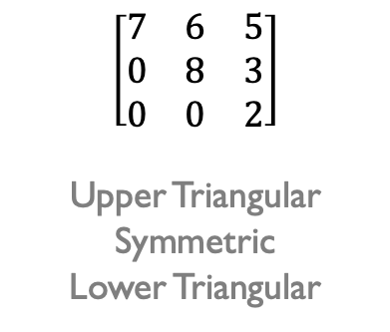
What Type of Matrix is This?
$$\left[\begin{matrix}4 & 5 & 9 \\ 7 & 3 & 8 \\ 2 & 6 & 1\end{matrix}\right]$$
Symmetric
Square
Lower Triangular
$$\left[\begin{matrix}4 & 5 & \begin{matrix}2 & 3\end{matrix} \\ 7 & 3 & \begin{matrix}9 & 7\end{matrix} \\ 2 & 6 & \begin{matrix}4 & 2\end{matrix}\end{matrix}\right]$$
Singular
Upper Triangular
Rectangular
$$\left[\begin{matrix}1 & 0 & 0 \\ 0 & −1 & 0 \\ 0 & 0 & 1\end{matrix}\right]$$
Diagonal
Identity
Symmetric
$$\left[\begin{matrix}1 & 0 & 0 \\ 0 & 1 & 0 \\ 0 & 0 & 1\end{matrix}\right]$$
Identity
Rectangular
Non-Singular
$$\left[\begin{matrix}7 & 6 & 5 \\ 0 & 8 & 3 \\ 0 & 0 & 2\end{matrix}\right]$$
Upper Triangular
Symmetric
Lower Triangular

Slide 31
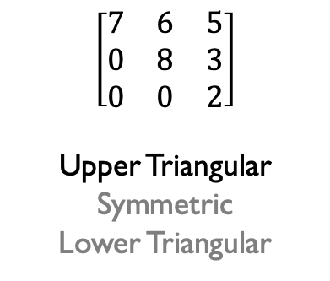
What Type of Matrix is This?
$$\left[\begin{matrix}4 & 5 & 9 \\ 7 & 3 & 8 \\ 2 & 6 & 1\end{matrix}\right]$$
Symmetric
Square
Lower Triangular
$$\left[\begin{matrix}4 & 5 & \begin{matrix}2 & 3\end{matrix} \\ 7 & 3 & \begin{matrix}9 & 7\end{matrix} \\ 2 & 6 & \begin{matrix}4 & 2\end{matrix}\end{matrix}\right]$$
Singular
Upper Triangular
Rectangular
$$\left[\begin{matrix}1 & 0 & 0 \\ 0 & −1 & 0 \\ 0 & 0 & 1\end{matrix}\right]$$
Diagonal
Identity
Symmetric
$$\left[\begin{matrix}1 & 0 & 0 \\ 0 & 1 & 0 \\ 0 & 0 & 1\end{matrix}\right]$$
Identity
Rectangular
Non-Singular
$$\left[\begin{matrix}7 & 6 & 5 \\ 0 & 8 & 3 \\ 0 & 0 & 2\end{matrix}\right]$$
Upper Triangular
Symmetric
Lower Triangular

Slide 32
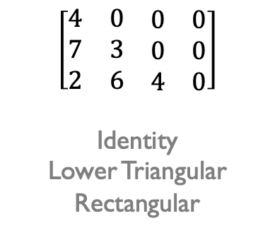
What Type of Matrix is This?
$$\left[\begin{matrix}4 & 5 & 9 \\ 7 & 3 & 8 \\ 2 & 6 & 1\end{matrix}\right]$$
Symmetric
Square
Lower Triangular
$$\left[\begin{matrix}4 & 5 & \begin{matrix}2 & 3\end{matrix} \\ 7 & 3 & \begin{matrix}9 & 7\end{matrix} \\ 2 & 6 & \begin{matrix}4 & 2\end{matrix}\end{matrix}\right]$$
Singular
Upper Triangular
Rectangular
$$\left[\begin{matrix}1 & 0 & 0 \\ 0 & −1 & 0 \\ 0 & 0 & 1\end{matrix}\right]$$
Diagonal
Identity
Symmetric
$$\left[\begin{matrix}1 & 0 & 0 \\ 0 & 1 & 0 \\ 0 & 0 & 1\end{matrix}\right]$$
Identity
Rectangular
Non-Singular
$$\left[\begin{matrix}7 & 6 & 5 \\ 0 & 8 & 3 \\ 0 & 0 & 2\end{matrix}\right]$$
Upper Triangular
Symmetric
Lower Triangular
$$\left[\begin{matrix}4 & 0 & \begin{matrix}0 & 0\end{matrix} \\ 7 & 3 & \begin{matrix}0 & 0\end{matrix} \\ 2 & 6 & \begin{matrix}4 & 0\end{matrix}\end{matrix}\right]$$
Identity
Lower Triangular
Rectangular

Slide 33
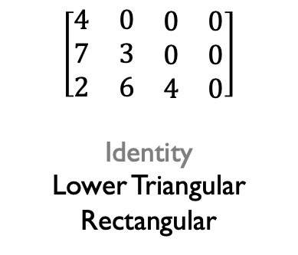
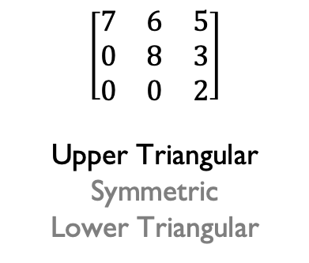
What Type of Matrix is This?
$$\left[\begin{matrix}4 & 5 & 9 \\ 7 & 3 & 8 \\ 2 & 6 & 1\end{matrix}\right]$$
Symmetric
Square
Lower Triangular
$$\left[\begin{matrix}4 & 5 & \begin{matrix}2 & 3\end{matrix} \\ 7 & 3 & \begin{matrix}9 & 7\end{matrix} \\ 2 & 6 & \begin{matrix}4 & 2\end{matrix}\end{matrix}\right]$$
Singular
Upper Triangular
Rectangular
$$\left[\begin{matrix}1 & 0 & 0 \\ 0 & −1 & 0 \\ 0 & 0 & 1\end{matrix}\right]$$
Diagonal
Identity
Symmetric
$$\left[\begin{matrix}1 & 0 & 0 \\ 0 & 1 & 0 \\ 0 & 0 & 1\end{matrix}\right]$$
Identity
Rectangular
Non-Singular
$$\left[\begin{matrix}7 & 6 & 5 \\ 0 & 8 & 3 \\ 0 & 0 & 2\end{matrix}\right]$$
Upper Triangular
Symmetric
Lower Triangular
$$\left[\begin{matrix}4 & 0 & \begin{matrix}0 & 0\end{matrix} \\ 7 & 3 & \begin{matrix}0 & 0\end{matrix} \\ 2 & 6 & \begin{matrix}4 & 0\end{matrix}\end{matrix}\right]$$
Identity
Lower Triangular
Rectangular

Slide 34
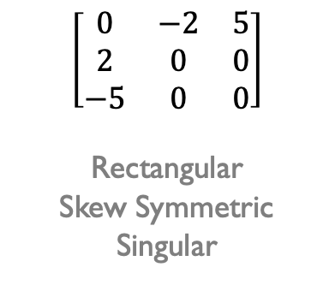
What Type of Matrix is This?
$$\left[\begin{matrix}4 & 5 & 9 \\ 7 & 3 & 8 \\ 2 & 6 & 1\end{matrix}\right]$$
Symmetric
Square
Lower Triangular
$$\left[\begin{matrix}4 & 5 & \begin{matrix}2 & 3\end{matrix} \\ 7 & 3 & \begin{matrix}9 & 7\end{matrix} \\ 2 & 6 & \begin{matrix}4 & 2\end{matrix}\end{matrix}\right]$$
Singular
Upper Triangular
Rectangular
$$\left[\begin{matrix}1 & 0 & 0 \\ 0 & −1 & 0 \\ 0 & 0 & 1\end{matrix}\right]$$
Diagonal
Identity
Symmetric
$$\left[\begin{matrix}1 & 0 & 0 \\ 0 & 1 & 0 \\ 0 & 0 & 1\end{matrix}\right]$$
Identity
Rectangular
Non-Singular
$$\left[\begin{matrix}7 & 6 & 5 \\ 0 & 8 & 3 \\ 0 & 0 & 2\end{matrix}\right]$$
Upper Triangular
Symmetric
Lower Triangular
$$\left[\begin{matrix}4 & 0 & \begin{matrix}0 & 0\end{matrix} \\ 7 & 3 & \begin{matrix}0 & 0\end{matrix} \\ 2 & 6 & \begin{matrix}4 & 0\end{matrix}\end{matrix}\right]$$
Identity
Lower Triangular
Rectangular
$$\left[\begin{matrix}0 & −2 & 5 \\ 2 & 0 & 0 \\ −5 & 0 & 0\end{matrix}\right]$$
Rectangular
Skew Symmetric
Singular

Slide 35
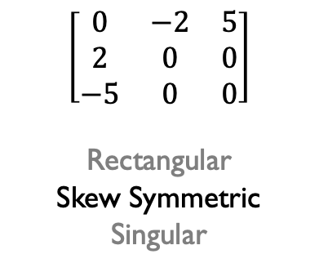
What Type of Matrix is This?
$$\left[\begin{matrix}4 & 5 & 9 \\ 7 & 3 & 8 \\ 2 & 6 & 1\end{matrix}\right]$$
Symmetric
Square
Lower Triangular
$$\left[\begin{matrix}4 & 5 & \begin{matrix}2 & 3\end{matrix} \\ 7 & 3 & \begin{matrix}9 & 7\end{matrix} \\ 2 & 6 & \begin{matrix}4 & 2\end{matrix}\end{matrix}\right]$$
Singular
Upper Triangular
Rectangular
$$\left[\begin{matrix}1 & 0 & 0 \\ 0 & −1 & 0 \\ 0 & 0 & 1\end{matrix}\right]$$
Diagonal
Identity
Symmetric
$$\left[\begin{matrix}1 & 0 & 0 \\ 0 & 1 & 0 \\ 0 & 0 & 1\end{matrix}\right]$$
Identity
Rectangular
Non-Singular
$$\left[\begin{matrix}7 & 6 & 5 \\ 0 & 8 & 3 \\ 0 & 0 & 2\end{matrix}\right]$$
Upper Triangular
Symmetric
Lower Triangular
$$\left[\begin{matrix}4 & 0 & \begin{matrix}0 & 0\end{matrix} \\ 7 & 3 & \begin{matrix}0 & 0\end{matrix} \\ 2 & 6 & \begin{matrix}4 & 0\end{matrix}\end{matrix}\right]$$
Identity
Lower Triangular
Rectangular
$$\left[\begin{matrix}0 & −2 & 5 \\ 2 & 0 & 0 \\ −5 & 0 & 0\end{matrix}\right]$$
Rectangular
Skew Symmetric
Singular

Slide 36
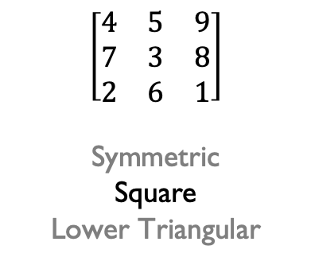
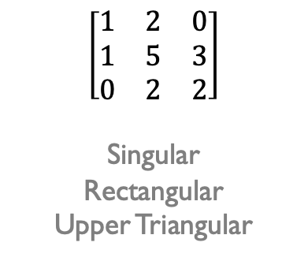
What Type of Matrix is This?
$$\left[\begin{matrix}4 & 5 & 9 \\ 7 & 3 & 8 \\ 2 & 6 & 1\end{matrix}\right]$$
Symmetric
Square
Lower Triangular
$$\left[\begin{matrix}4 & 5 & \begin{matrix}2 & 3\end{matrix} \\ 7 & 3 & \begin{matrix}9 & 7\end{matrix} \\ 2 & 6 & \begin{matrix}4 & 2\end{matrix}\end{matrix}\right]$$
Singular
Upper Triangular
Rectangular
$$\left[\begin{matrix}1 & 0 & 0 \\ 0 & −1 & 0 \\ 0 & 0 & 1\end{matrix}\right]$$
Diagonal
Identity
Symmetric
$$\left[\begin{matrix}1 & 0 & 0 \\ 0 & 1 & 0 \\ 0 & 0 & 1\end{matrix}\right]$$
Identity
Rectangular
Non-Singular
$$\left[\begin{matrix}7 & 6 & 5 \\ 0 & 8 & 3 \\ 0 & 0 & 2\end{matrix}\right]$$
Upper Triangular
Symmetric
Lower Triangular
$$\left[\begin{matrix}4 & 0 & \begin{matrix}0 & 0\end{matrix} \\ 7 & 3 & \begin{matrix}0 & 0\end{matrix} \\ 2 & 6 & \begin{matrix}4 & 0\end{matrix}\end{matrix}\right]$$
Identity
Lower Triangular
Rectangular
$$\left[\begin{matrix}0 & −2 & 5 \\ 2 & 0 & 0 \\ −5 & 0 & 0\end{matrix}\right]$$
Rectangular
Skew Symmetric
Singular
$$\left[\begin{matrix}1 & 2 & 0 \\ 1 & 5 & 3 \\ 0 & 2 & 2\end{matrix}\right]$$
Singular
Rectangular
Upper Triangular

Slide 37
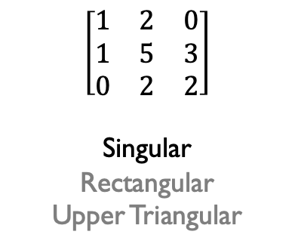
What Type of Matrix is This?
$$\left[\begin{matrix}4 & 5 & 9 \\ 7 & 3 & 8 \\ 2 & 6 & 1\end{matrix}\right]$$
Symmetric
Square
Lower Triangular
$$\left[\begin{matrix}4 & 5 & \begin{matrix}2 & 3\end{matrix} \\ 7 & 3 & \begin{matrix}9 & 7\end{matrix} \\ 2 & 6 & \begin{matrix}4 & 2\end{matrix}\end{matrix}\right]$$
Singular
Upper Triangular
Rectangular
$$\left[\begin{matrix}1 & 0 & 0 \\ 0 & −1 & 0 \\ 0 & 0 & 1\end{matrix}\right]$$
Diagonal
Identity
Symmetric
$$\left[\begin{matrix}1 & 0 & 0 \\ 0 & 1 & 0 \\ 0 & 0 & 1\end{matrix}\right]$$
Identity
Rectangular
Non-Singular
$$\left[\begin{matrix}7 & 6 & 5 \\ 0 & 8 & 3 \\ 0 & 0 & 2\end{matrix}\right]$$
Upper Triangular
Symmetric
Lower Triangular
$$\left[\begin{matrix}4 & 0 & \begin{matrix}0 & 0\end{matrix} \\ 7 & 3 & \begin{matrix}0 & 0\end{matrix} \\ 2 & 6 & \begin{matrix}4 & 0\end{matrix}\end{matrix}\right]$$
Identity
Lower Triangular
Rectangular
$$\left[\begin{matrix}0 & −2 & 5 \\ 2 & 0 & 0 \\ −5 & 0 & 0\end{matrix}\right]$$
Rectangular
Skew Symmetric
Singular
$$\left[\begin{matrix}1 & 2 & 0 \\ 1 & 5 & 3 \\ 0 & 2 & 2\end{matrix}\right]$$
Singular
Rectangular
Upper Triangular
Determinant
= 1(5*2 – 3*2) +
2(3*0 – 1*2) +
0(1*2 – 5*0)
= 4 – 4 + 0
= 0

Slide 38
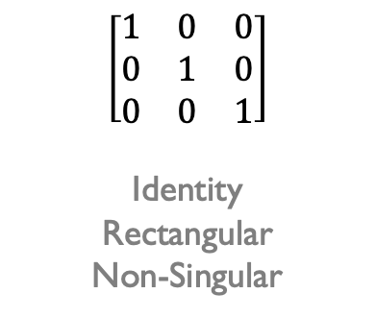
What Type of Matrix is This?
$$\left[\begin{matrix}4 & 5 & 9 \\ 7 & 3 & 8 \\ 2 & 6 & 1\end{matrix}\right]$$
Symmetric
Square
Lower Triangular
$$\left[\begin{matrix}4 & 5 & \begin{matrix}2 & 3\end{matrix} \\ 7 & 3 & \begin{matrix}9 & 7\end{matrix} \\ 2 & 6 & \begin{matrix}4 & 2\end{matrix}\end{matrix}\right]$$
Singular
Upper Triangular
Rectangular
$$\left[\begin{matrix}1 & 0 & 0 \\ 0 & −1 & 0 \\ 0 & 0 & 1\end{matrix}\right]$$
Diagonal
Identity
Symmetric
$$\left[\begin{matrix}1 & 0 & 0 \\ 0 & 1 & 0 \\ 0 & 0 & 1\end{matrix}\right]$$
Identity
Rectangular
Non-Singular
$$\left[\begin{matrix}7 & 6 & 5 \\ 0 & 8 & 3 \\ 0 & 0 & 2\end{matrix}\right]$$
Upper Triangular
Symmetric
Lower Triangular
$$\left[\begin{matrix}4 & 0 & \begin{matrix}0 & 0\end{matrix} \\ 7 & 3 & \begin{matrix}0 & 0\end{matrix} \\ 2 & 6 & \begin{matrix}4 & 0\end{matrix}\end{matrix}\right]$$
Identity
Lower Triangular
Rectangular
$$\left[\begin{matrix}0 & −2 & 5 \\ 2 & 0 & 0 \\ −5 & 0 & 0\end{matrix}\right]$$
Rectangular
Skew Symmetric
Singular
$$\left[\begin{matrix}1 & 2 & 0 \\ 1 & 5 & 3 \\ 0 & 2 & 2\end{matrix}\right]$$
Singular
Rectangular
Upper Triangular
Determinant = 1(5*2 – 3*2) + 2(3*0 - 1*2) + 0(1*2 – 5*0)

Slide 39
Matrix & Vector Operations
Inner product (dot product)
Outer product
Matrix-vector multiplication
Matrix-matrix multiplication
Transpose

Slide 40
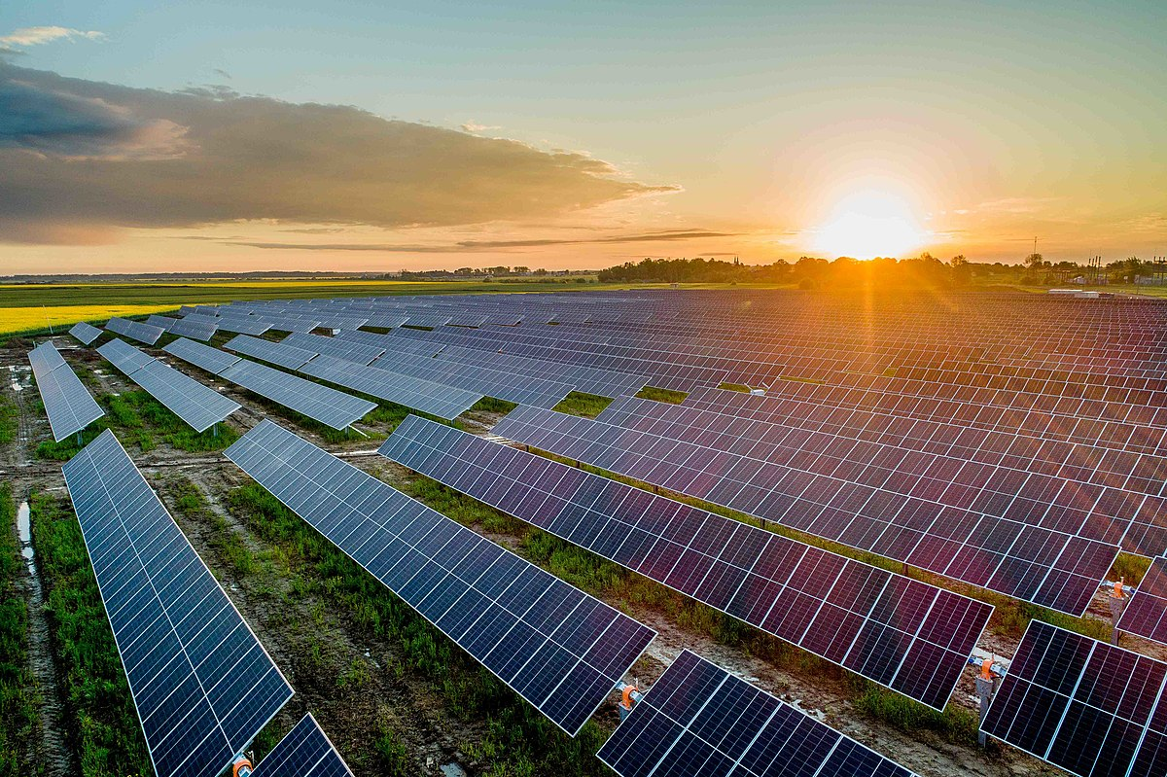
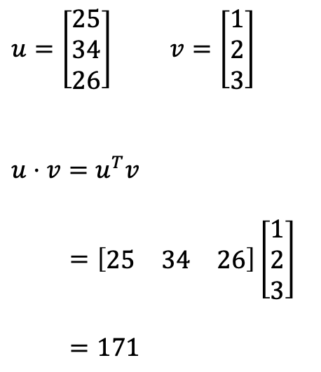
Inner Product (Dot Product)
Applications:
Maximize efficiency of solar panels by adjusting their tilt so that they face the sunlight directly
In natural language processing, compare two documents using cosine similarity, which uses dot product at its heart
$u=\left[\begin{matrix}25 \\ 34 \\ 26\end{matrix}\right]$ $v=\left[\begin{matrix}1 \\ 2 \\ 3\end{matrix}\right]$
$$u⋅v=u^{T}v$$
$=\left[\begin{matrix}25 & 34 & 26\end{matrix}\right]\left[\begin{matrix}1 \\ 2 \\ 3\end{matrix}\right]$
$=171$

Slide 41
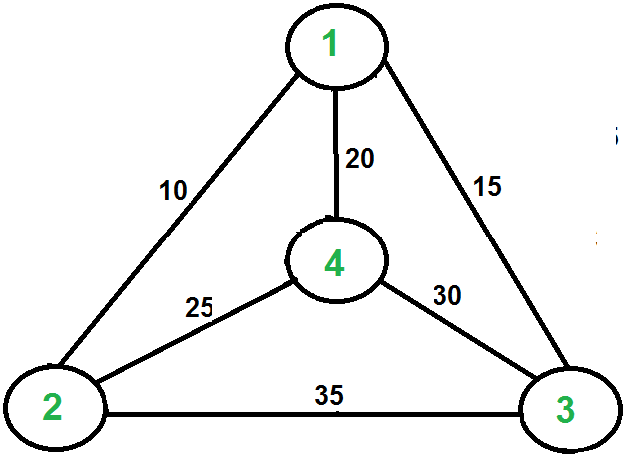
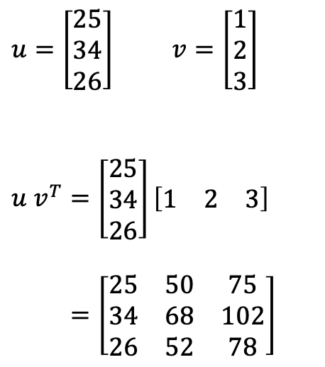
Outer Product
Applications:
Speeding up execution of programs at the compiler level
Designing quantum gates in quantum computing
Computing pairwise distances between cities in the Traveling Salesman Problem (TSP)
$u=\left[\begin{matrix}25 \\ 34 \\ 26\end{matrix}\right]$ $v=\left[\begin{matrix}1 \\ 2 \\ 3\end{matrix}\right]$
$$u v^{T}=\left[\begin{matrix}25 \\ 34 \\ 26\end{matrix}\right]\left[\begin{matrix}1 & 2 & 3\end{matrix}\right]$$
$=\left[\begin{matrix}25 & 50 & 75 \\ 34 & 68 & 102 \\ 26 & 52 & 78\end{matrix}\right]$

Slide 42
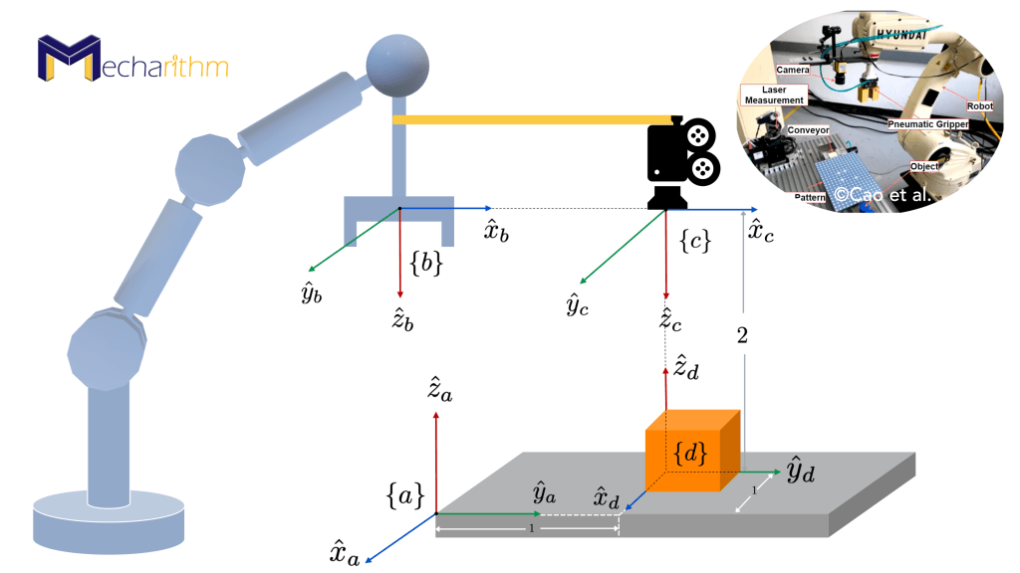
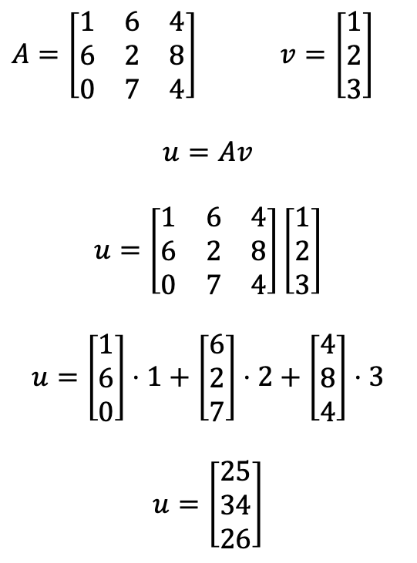
Matrix-Vector Product
Applications:
Industrial robotics
Single layer computation in a deep neural network
Simulations: Monte Carlo, Finite Element Method (FEM), Computational Fluid Dynamics
$A=\left[\begin{matrix}1 & 6 & 4 \\ 6 & 2 & 8 \\ 0 & 7 & 4\end{matrix}\right]$ $v=\left[\begin{matrix}1 \\ 2 \\ 3\end{matrix}\right]$
$$u=Av$$
$$u=\left[\begin{matrix}1 & 6 & 4 \\ 6 & 2 & 8 \\ 0 & 7 & 4\end{matrix}\right]\left[\begin{matrix}1 \\ 2 \\ 3\end{matrix}\right]$$
$$u=\left[\begin{matrix}1 \\ 6 \\ 0\end{matrix}\right]⋅1+\left[\begin{matrix}6 \\ 2 \\ 7\end{matrix}\right]⋅2+\left[\begin{matrix}4 \\ 8 \\ 4\end{matrix}\right]⋅3$$
$$u=\left[\begin{matrix}25 \\ 34 \\ 26\end{matrix}\right]$$

Slide 43
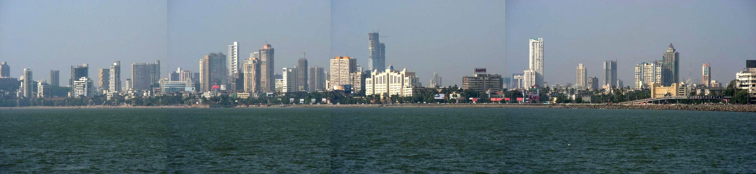
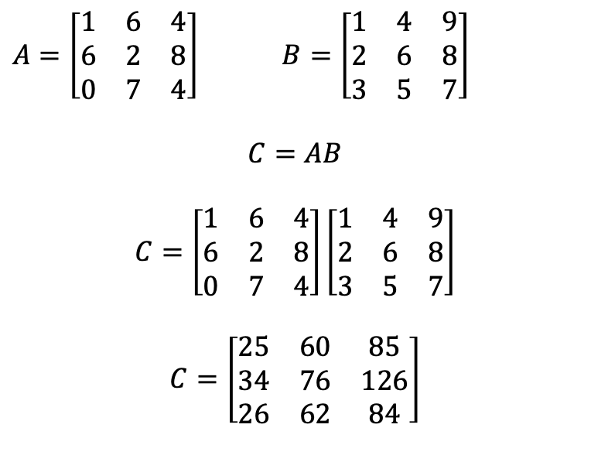
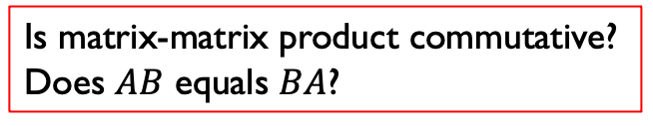
Matrix-Matrix Product
Applications:
Panorama: 3D view on 2D image
360-degree photo: Stitching 2D images into 3D object for virtual reality applications
Instagram filters (scaling, rotating etc.)
$A=\left[\begin{matrix}1 & 6 & 4 \\ 6 & 2 & 8 \\ 0 & 7 & 4\end{matrix}\right]$ $B=\left[\begin{matrix}1 & 4 & 9 \\ 2 & 6 & 8 \\ 3 & 5 & 7\end{matrix}\right]$
$$C=AB$$
$$C=\left[\begin{matrix}1 & 6 & 4 \\ 6 & 2 & 8 \\ 0 & 7 & 4\end{matrix}\right]\left[\begin{matrix}1 & 4 & 9 \\ 2 & 6 & 8 \\ 3 & 5 & 7\end{matrix}\right]$$
$$C=\left[\begin{matrix}25 & 60 & 85 \\ 34 & 76 & 126 \\ 26 & 62 & 84\end{matrix}\right]$$
Is matrix-matrix product commutative? Does $AB$ equals $BA$?
Panorama image of Mumbai

Slide 44




Transpose of a Matrix
$$A=\left[\begin{matrix}1 & 6 & 4 \\ 6 & 2 & 8 \\ 0 & 7 & 4\end{matrix}\right]$$
$$A^{T}=\left[\begin{matrix}1 & 6 & 0 \\ 6 & 2 & 7 \\ 4 & 8 & 4\end{matrix}\right]$$
Application: Auto-rotate feature on smart phones.

Slide 45
Eigenvalues and Eigenvectors
80 IE seats and 100 IM seats
Each year:
30% IE seats converted into IM seats
20% IM seats converted into IE seats
Total number of seats (IE + IM) remains the same

Slide 46
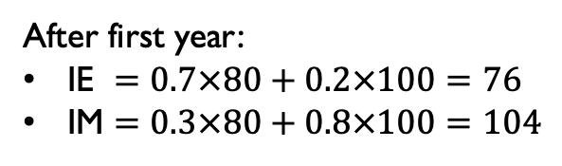
Eigenvalues and Eigenvectors
80 IE seats and 100 IM seats
Each year:
30% IE seats converted into IM seats
20% IM seats converted into IE seats
Total number of seats (IE + IM) remains the same
After first year:
IE $=0.7×80+0.2×100=76$
IM $=0.3×80+0.8×100=104$

Slide 47
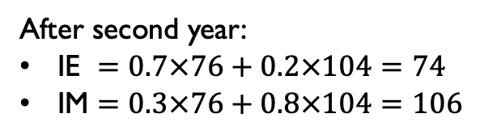
Eigenvalues and Eigenvectors
80 IE seats and 100 IM seats
Each year:
30% IE seats converted into IM seats
20% IM seats converted into IE seats
Total number of seats (IE + IM) remains the same
After first year:
IE $=0.7×80+0.2×100=76$
IM $=0.3×80+0.8×100=104$
After second year:
IE $=0.7×76+0.2×104=74$
IM $=0.3×76+0.8×104=106$

Slide 48
Eigenvalues and Eigenvectors
80 IE seats and 100 IM seats
Each year:
30% IE seats converted into IM seats
20% IM seats converted into IE seats
Total number of seats (IE + IM) remains the same
Year | IE | IM
Year 0 | 80 | 100
Year 1 | 76 | 104
Year 2 | 74 | 106
After first year:
IE $=0.7×80+0.2×100=76$
IM $=0.3×80+0.8×100=104$
After second year:
IE $=0.7×76+0.2×104=74$
IM $=0.3×76+0.8×104=106$

Slide 49
Eigenvalues and Eigenvectors
80 IE seats and 100 IM seats
Each year:
30% IE seats converted into IM seats
20% IM seats converted into IE seats
Total number of seats (IE + IM) remains the same
Year | IE | IM
Year 0 | 80 | 100
Year 1 | 76 | 104
Year 2 | 74 | 106
After first year:
IE $=0.7×80+0.2×100=76$
IM $=0.3×80+0.8×100=104$
After second year:
IE $=0.7×76+0.2×104=74$
IM $=0.3×76+0.8×104=106$
Will the IE seats go to zero eventually?

Slide 50





Eigenvalues and Eigenvectors
80 IE seats and 100 IM seats
Each year:
30% IE seats converted into IM seats
20% IM seats converted into IE seats
Total number of seats (IE + IM) remains the same
$y$ (IM)
$$(0,180)$$
Year | IE | IM
Year 0 | 80 | 100
Year 1 | 76 | 104
Year 2 | 74 | 106
After first year:
IE $=0.7×80+0.2×100=76$
IM $=0.3×80+0.8×100=104$
$$x+y=180$$
$$(180,0)$$
$x$ (IE)
After second year:
IE $=0.7×76+0.2×104=74$
IM $=0.3×76+0.8×104=106$
Will the IE seats go to zero eventually?

Slide 51

Eigenvalues and Eigenvectors
80 IE seats and 100 IM seats
Each year:
30% IE seats converted into IM seats
20% IM seats converted into IE seats
Total number of seats (IE + IM) remains the same
$y$ (IM)
$$(0,180)$$
$$t_{0}=(80, 100)$$
Year | IE | IM
Year 0 | 80 | 100
Year 1 | 76 | 104
Year 2 | 74 | 106
After first year:
IE $=0.7×80+0.2×100=76$
IM $=0.3×80+0.8×100=104$
$$x+y=180$$
$$(180,0)$$
$x$ (IE)
After second year:
IE $=0.7×76+0.2×104=74$
IM $=0.3×76+0.8×104=106$
Will the IE seats go to zero eventually?

Slide 52

Eigenvalues and Eigenvectors
80 IE seats and 100 IM seats
Each year:
30% IE seats converted into IM seats
20% IM seats converted into IE seats
Total number of seats (IE + IM) remains the same
$y$ (IM)
$$(0,180)$$
$$t_{1}=(76, 104)$$
$$t_{0}=(80, 100)$$
Year | IE | IM
Year 0 | 80 | 100
Year 1 | 76 | 104
Year 2 | 74 | 106
After first year:
IE $=0.7×80+0.2×100=76$
IM $=0.3×80+0.8×100=104$
$$x+y=180$$
$$(180,0)$$
$x$ (IE)
After second year:
IE $=0.7×76+0.2×104=74$
IM $=0.3×76+0.8×104=106$
Will the IE seats go to zero eventually?

Slide 53

Eigenvalues and Eigenvectors
80 IE seats and 100 IM seats
Each year:
30% IE seats converted into IM seats
20% IM seats converted into IE seats
Total number of seats (IE + IM) remains the same
$y$ (IM)
$$(0,180)$$
$$t_{2}=(74, 106)$$
$$t_{1}=(76, 104)$$
$$t_{0}=(80, 100)$$
Year | IE | IM
Year 0 | 80 | 100
Year 1 | 76 | 104
Year 2 | 74 | 106
After first year:
IE $=0.7×80+0.2×100=76$
IM $=0.3×80+0.8×100=104$
$$x+y=180$$
$$(180,0)$$
$x$ (IE)
After second year:
IE $=0.7×76+0.2×104=74$
IM $=0.3×76+0.8×104=106$
Will the IE seats go to zero eventually?

Slide 54



Eigenvalues and eigenvectors
After first year:
IE $=0.7×80+0.2×100=76$
IM $=0.3×80+0.8×100=104$
$y$ (IM)
$$(0,180)$$
$t_{0}=\left[\begin{matrix}80 \\ 100\end{matrix}\right]$ $P=\left[\begin{matrix}0.7 & 0.2 \\ 0.3 & 0.8\end{matrix}\right]$
$$t_{0}=(80, 100)$$
$$x+y=180$$
$$(180,0)$$
$x$ (IE)

Slide 55


Eigenvalues and eigenvectors
After first year:
IE $=0.7×80+0.2×100=76$
IM $=0.3×80+0.8×100=104$
$y$ (IM)
$$(0,180)$$
$t_{0}=\left[\begin{matrix}80 \\ 100\end{matrix}\right]$ $P=\left[\begin{matrix}0.7 & 0.2 \\ 0.3 & 0.8\end{matrix}\right]$
$$t_{1}=Pt_{0}=\left[\begin{matrix}0.7 & 0.2 \\ 0.3 & 0.8\end{matrix}\right]\left[\begin{matrix}80 \\ 100\end{matrix}\right]=\left[\begin{matrix}76 \\ 104\end{matrix}\right]$$
$$t_{1}=(76, 104)$$
$$t_{0}=(80, 100)$$
$$x+y=180$$
$$(180,0)$$
$x$ (IE)

Slide 56


Eigenvalues and eigenvectors
After first year:
IE $=0.7×80+0.2×100=76$
IM $=0.3×80+0.8×100=104$
$y$ (IM)
$$(0,180)$$
$t_{0}=\left[\begin{matrix}80 \\ 100\end{matrix}\right]$ $P=\left[\begin{matrix}0.7 & 0.2 \\ 0.3 & 0.8\end{matrix}\right]$
$$t_{1}=Pt_{0}=\left[\begin{matrix}0.7 & 0.2 \\ 0.3 & 0.8\end{matrix}\right]\left[\begin{matrix}80 \\ 100\end{matrix}\right]=\left[\begin{matrix}76 \\ 104\end{matrix}\right]$$
$$t_{2}=Pt_{1}=\left[\begin{matrix}0.7 & 0.2 \\ 0.3 & 0.8\end{matrix}\right]\left[\begin{matrix}76 \\ 104\end{matrix}\right]=\left[\begin{matrix}74 \\ 106\end{matrix}\right]$$
$$t_{2}=(74, 106)$$
$$t_{1}=(76, 104)$$
$$t_{0}=(80, 100)$$
$$x+y=180$$
$$(180,0)$$
$x$ (IE)

Slide 57


Eigenvalues and eigenvectors
After first year:
IE $=0.7×80+0.2×100=76$
IM $=0.3×80+0.8×100=104$
$y$ (IM)
$$(0,180)$$
$$t_{3}=(73, 107)$$
$t_{0}=\left[\begin{matrix}80 \\ 100\end{matrix}\right]$ $P=\left[\begin{matrix}0.7 & 0.2 \\ 0.3 & 0.8\end{matrix}\right]$
$$t_{1}=Pt_{0}=\left[\begin{matrix}0.7 & 0.2 \\ 0.3 & 0.8\end{matrix}\right]\left[\begin{matrix}80 \\ 100\end{matrix}\right]=\left[\begin{matrix}76 \\ 104\end{matrix}\right]$$
$$t_{2}=Pt_{1}=\left[\begin{matrix}0.7 & 0.2 \\ 0.3 & 0.8\end{matrix}\right]\left[\begin{matrix}76 \\ 104\end{matrix}\right]=\left[\begin{matrix}74 \\ 106\end{matrix}\right]$$
$$t_{3}=Pt_{2}=\left[\begin{matrix}0.7 & 0.2 \\ 0.3 & 0.8\end{matrix}\right]\left[\begin{matrix}74 \\ 106\end{matrix}\right]=\left[\begin{matrix}73 \\ 107\end{matrix}\right]$$
$$t_{2}=(74, 106)$$
$$t_{1}=(76, 104)$$
$$t_{0}=(80, 100)$$
$$x+y=180$$
$$(180,0)$$
$x$ (IE)

Slide 58


Eigenvalues and eigenvectors
After first year:
IE $=0.7×80+0.2×100=76$
IM $=0.3×80+0.8×100=104$
$y$ (IM)
$$(0,180)$$
$$t_{4}=(72, 108)$$
$$t_{3}=(73, 107)$$
$t_{0}=\left[\begin{matrix}80 \\ 100\end{matrix}\right]$ $P=\left[\begin{matrix}0.7 & 0.2 \\ 0.3 & 0.8\end{matrix}\right]$
$$t_{1}=Pt_{0}=\left[\begin{matrix}0.7 & 0.2 \\ 0.3 & 0.8\end{matrix}\right]\left[\begin{matrix}80 \\ 100\end{matrix}\right]=\left[\begin{matrix}76 \\ 104\end{matrix}\right]$$
$$t_{2}=Pt_{1}=\left[\begin{matrix}0.7 & 0.2 \\ 0.3 & 0.8\end{matrix}\right]\left[\begin{matrix}76 \\ 104\end{matrix}\right]=\left[\begin{matrix}74 \\ 106\end{matrix}\right]$$
$$t_{3}=Pt_{2}=\left[\begin{matrix}0.7 & 0.2 \\ 0.3 & 0.8\end{matrix}\right]\left[\begin{matrix}74 \\ 106\end{matrix}\right]=\left[\begin{matrix}73 \\ 107\end{matrix}\right]$$
$$t_{4}=Pt_{3}=\left[\begin{matrix}0.7 & 0.2 \\ 0.3 & 0.8\end{matrix}\right]\left[\begin{matrix}73 \\ 107\end{matrix}\right]=\left[\begin{matrix}72 \\ 108\end{matrix}\right]$$
$$t_{2}=(74, 106)$$
$$t_{1}=(76, 104)$$
$$t_{0}=(80, 100)$$
$$x+y=180$$
$$(180,0)$$
$x$ (IE)

Slide 59


Eigenvalues and eigenvectors
After first year:
IE $=0.7×80+0.2×100=76$
IM $=0.3×80+0.8×100=104$
$y$ (IM)
$$(0,180)$$
$$t_{5}=t_{4}=(72, 108)$$
$$t_{3}=(73, 107)$$
$t_{0}=\left[\begin{matrix}80 \\ 100\end{matrix}\right]$ $P=\left[\begin{matrix}0.7 & 0.2 \\ 0.3 & 0.8\end{matrix}\right]$
$$t_{1}=Pt_{0}=\left[\begin{matrix}0.7 & 0.2 \\ 0.3 & 0.8\end{matrix}\right]\left[\begin{matrix}80 \\ 100\end{matrix}\right]=\left[\begin{matrix}76 \\ 104\end{matrix}\right]$$
$$t_{2}=Pt_{1}=\left[\begin{matrix}0.7 & 0.2 \\ 0.3 & 0.8\end{matrix}\right]\left[\begin{matrix}76 \\ 104\end{matrix}\right]=\left[\begin{matrix}74 \\ 106\end{matrix}\right]$$
$$t_{3}=Pt_{2}=\left[\begin{matrix}0.7 & 0.2 \\ 0.3 & 0.8\end{matrix}\right]\left[\begin{matrix}74 \\ 106\end{matrix}\right]=\left[\begin{matrix}73 \\ 107\end{matrix}\right]$$
$$t_{4}=Pt_{3}=\left[\begin{matrix}0.7 & 0.2 \\ 0.3 & 0.8\end{matrix}\right]\left[\begin{matrix}73 \\ 107\end{matrix}\right]=\left[\begin{matrix}72 \\ 108\end{matrix}\right]$$
$$t_{5}=Pt_{4}=\left[\begin{matrix}0.7 & 0.2 \\ 0.3 & 0.8\end{matrix}\right]\left[\begin{matrix}72 \\ 108\end{matrix}\right]=\left[\begin{matrix}72 \\ 108\end{matrix}\right]$$
$$t_{2}=(74, 106)$$
$$t_{1}=(76, 104)$$
$$t_{0}=(80, 100)$$
$$x+y=180$$
$$(180,0)$$
$x$ (IE)

Slide 60
Eigenvalues and eigenvectors
After first year:
IE $=0.7×80+0.2×100=76$
IM $=0.3×80+0.8×100=104$
$y$ (IM)
Year | IE | IM
Year 0 | 80 | 100
Year 1 | 76 | 104
Year 2 | 74 | 106
Year 3 | 73 | 107
Year 4 | 72 | 108
Year 5 | 72 | 108
$$(0,180)$$
$$t_{5}=t_{4}=(72, 108)$$
$$t_{3}=(73, 107)$$
$t_{0}=\left[\begin{matrix}80 \\ 100\end{matrix}\right]$ $P=\left[\begin{matrix}0.7 & 0.2 \\ 0.3 & 0.8\end{matrix}\right]$
$$t_{1}=Pt_{0}=\left[\begin{matrix}0.7 & 0.2 \\ 0.3 & 0.8\end{matrix}\right]\left[\begin{matrix}80 \\ 100\end{matrix}\right]=\left[\begin{matrix}76 \\ 104\end{matrix}\right]$$
$$t_{2}=Pt_{1}=\left[\begin{matrix}0.7 & 0.2 \\ 0.3 & 0.8\end{matrix}\right]\left[\begin{matrix}76 \\ 104\end{matrix}\right]=\left[\begin{matrix}74 \\ 106\end{matrix}\right]$$
$$t_{3}=Pt_{2}=\left[\begin{matrix}0.7 & 0.2 \\ 0.3 & 0.8\end{matrix}\right]\left[\begin{matrix}74 \\ 106\end{matrix}\right]=\left[\begin{matrix}73 \\ 107\end{matrix}\right]$$
$$t_{4}=Pt_{3}=\left[\begin{matrix}0.7 & 0.2 \\ 0.3 & 0.8\end{matrix}\right]\left[\begin{matrix}73 \\ 107\end{matrix}\right]=\left[\begin{matrix}72 \\ 108\end{matrix}\right]$$
$$t_{5}=Pt_{4}=\left[\begin{matrix}0.7 & 0.2 \\ 0.3 & 0.8\end{matrix}\right]\left[\begin{matrix}72 \\ 108\end{matrix}\right]=\left[\begin{matrix}72 \\ 108\end{matrix}\right]$$
$$t_{2}=(74, 106)$$
$$t_{1}=(76, 104)$$
$$t_{0}=(80, 100)$$
$$x+y=180$$
$$(180,0)$$
$x$ (IE)
This is an example of a Markov Chain process, widely used in probabilistic simulations.

Slide 61

Eigenvalues and eigenvectors
Vectors along certain directions are not rotated by the matrix, only scaled
These directions are called eigenvectors and their corresponding scaling factors are called eigenvalues!
Eigenvalues (and eigenvectors) exist for every square matrix, but they may be complex numbers/vectors
$y$ (IM)
$$(0,180)$$
$$t_{5}=t_{4}=(72, 108)$$
$$t_{3}=(73, 107)$$
$$t_{2}=(74, 106)$$
$$t_{1}=(76, 104)$$
$$t_{0}=(80, 100)$$
$$x+y=180$$
The matrix under consideration, $P=\left[\begin{matrix}0.7 & 0.2 \\ 0.3 & 0.8\end{matrix}\right]$, has two eigenvalues: $1.0$ and $0.5$.
Corresponding eigenvectors are $\left[\begin{matrix}−2 \\ −3\end{matrix}\right]$ and $\left[\begin{matrix}1 \\ −1\end{matrix}\right]$.
$$(180,0)$$
$x$ (IE)

Slide 62
Special Matrices
Positive Definite, Positive Semi-Definite, Negative Definite, Negative Semi-Definite
Stochastic
Orthogonal
Orthonormal

Slide 63

Special Matrices
$$\left[\begin{matrix}0.7 & 0.2 \\ 0.3 & 0.8\end{matrix}\right]$$
Stochastic: All columns follow probability distribution.
Positive Definite: All eigenvalues are positive.

Slide 64
Special Matrices
$$\left[\begin{matrix}0.7 & 0.2 \\ 0.3 & 0.8\end{matrix}\right]$$
Stochastic: All columns follow probability distribution.
Positive Definite: All eigenvalues are positive.
Positive Semi-Definite: All eigenvalues are non-negative.
Negative Definite: All eigenvalues are negative.
Negative Semi-Definite: All eigenvalues are non-positive.

Slide 65

Special Matrices
$$\left[\begin{matrix}0.7 & 0.2 \\ 0.3 & 0.8\end{matrix}\right]$$
Stochastic: All columns follow probability distribution.
Positive Definite: All eigenvalues are positive.
$$\frac{1}{3}\left[\begin{matrix}2 & 1 & −2 \\ 1 & 2 & 2 \\ 2 & −2 & 1\end{matrix}\right]$$
Orthonormal/Orthogonal: All columns are orthogonal (perpendicular) to each other and normalized.
Has complex eigenvalues
Inverse equals transpose
Positive Semi-Definite: All eigenvalues are non-negative.
Negative Definite: All eigenvalues are negative.
Negative Semi-Definite: All eigenvalues are non-positive.

Slide 66
Eigen-Decomposition
After first year:
IE $=0.7×80+0.2×100=76$
IM $=0.3×80+0.8×100=104$
$y$ (IM)
Year | IE | IM
Year 0 | 80 | 100
Year 1 | 76 | 104
Year 2 | 74 | 106
Year 3 | 73 | 107
Year 4 | 72 | 108
Year 5 | 72 | 108
$$(0,180)$$
$$t_{5}=t_{4}=(72, 108)$$
$$t_{3}=(73, 107)$$
$t_{0}=\left[\begin{matrix}80 \\ 100\end{matrix}\right]$ $P=\left[\begin{matrix}0.7 & 0.2 \\ 0.3 & 0.8\end{matrix}\right]$
$$t_{1}=Pt_{0}=\left[\begin{matrix}0.7 & 0.2 \\ 0.3 & 0.8\end{matrix}\right]\left[\begin{matrix}80 \\ 100\end{matrix}\right]=\left[\begin{matrix}76 \\ 104\end{matrix}\right]$$
$$t_{2}=Pt_{1}=\left[\begin{matrix}0.7 & 0.2 \\ 0.3 & 0.8\end{matrix}\right]\left[\begin{matrix}76 \\ 104\end{matrix}\right]=\left[\begin{matrix}74 \\ 106\end{matrix}\right]$$
$$t_{3}=Pt_{2}=\left[\begin{matrix}0.7 & 0.2 \\ 0.3 & 0.8\end{matrix}\right]\left[\begin{matrix}74 \\ 106\end{matrix}\right]=\left[\begin{matrix}73 \\ 107\end{matrix}\right]$$
$$t_{4}=Pt_{3}=\left[\begin{matrix}0.7 & 0.2 \\ 0.3 & 0.8\end{matrix}\right]\left[\begin{matrix}73 \\ 107\end{matrix}\right]=\left[\begin{matrix}72 \\ 108\end{matrix}\right]$$
$$t_{5}=Pt_{4}=\left[\begin{matrix}0.7 & 0.2 \\ 0.3 & 0.8\end{matrix}\right]\left[\begin{matrix}72 \\ 108\end{matrix}\right]=\left[\begin{matrix}72 \\ 108\end{matrix}\right]$$
$$t_{2}=(74, 106)$$
$$t_{1}=(76, 104)$$
$$t_{0}=(80, 100)$$
$$x+y=180$$
$$(180,0)$$
$x$ (IE)

Slide 67

Eigen-Decomposition
After first year:
IE $=0.7×80+0.2×100=76$
IM $=0.3×80+0.8×100=104$
$y$ (IM)
Year | IE | IM
Year 0 | 80 | 100
Year 1 | 76 | 104
Year 2 | 74 | 106
Year 3 | 73 | 107
Year 4 | 72 | 108
Year 5 | 72 | 108
$$(0,180)$$
$$t_{5}=t_{4}=(72, 108)$$
$$t_{3}=(73, 107)$$
$t_{0}=\left[\begin{matrix}80 \\ 100\end{matrix}\right]$ $P=\left[\begin{matrix}0.7 & 0.2 \\ 0.3 & 0.8\end{matrix}\right]$
$$t_{1}=Pt_{0}=\left[\begin{matrix}0.7 & 0.2 \\ 0.3 & 0.8\end{matrix}\right]\left[\begin{matrix}80 \\ 100\end{matrix}\right]=\left[\begin{matrix}76 \\ 104\end{matrix}\right]$$
$$t_{2}=Pt_{1}=\left[\begin{matrix}0.7 & 0.2 \\ 0.3 & 0.8\end{matrix}\right]\left[\begin{matrix}76 \\ 104\end{matrix}\right]=\left[\begin{matrix}74 \\ 106\end{matrix}\right]$$
$$t_{3}=Pt_{2}=\left[\begin{matrix}0.7 & 0.2 \\ 0.3 & 0.8\end{matrix}\right]\left[\begin{matrix}74 \\ 106\end{matrix}\right]=\left[\begin{matrix}73 \\ 107\end{matrix}\right]$$
$$t_{4}=Pt_{3}=\left[\begin{matrix}0.7 & 0.2 \\ 0.3 & 0.8\end{matrix}\right]\left[\begin{matrix}73 \\ 107\end{matrix}\right]=\left[\begin{matrix}72 \\ 108\end{matrix}\right]$$
$$t_{5}=Pt_{4}=\left[\begin{matrix}0.7 & 0.2 \\ 0.3 & 0.8\end{matrix}\right]\left[\begin{matrix}72 \\ 108\end{matrix}\right]=\left[\begin{matrix}72 \\ 108\end{matrix}\right]$$
$$t_{2}=(74, 106)$$
$$t_{1}=(76, 104)$$
$$t_{0}=(80, 100)$$
$$x+y=180$$
$$t_{5}=P^{5}t_{0}$$
$=P×P×$ $P×$ $P×$ $P×t_{0}$
$$(180,0)$$
$x$ (IE)
5 matrix multiplications – computationally expensive! Can we reduce?

Slide 68

Eigen-Decomposition
$$P=VΛV^{−1}$$
$V$: Matrix of all eigenvectors stacked horizontally
$Λ$: Diagonal matrix of eigenvalues
$V^{−1}$: Inverse of $V$

Slide 69

Eigen-Decomposition
$$P=VΛV^{−1}$$
$V$: Matrix of all eigenvectors stacked horizontally
$Λ$: Diagonal matrix of eigenvalues
$V^{−1}$: Inverse of $V$
$P=\left[\begin{matrix}0.7 & 0.2 \\ 0.3 & 0.8\end{matrix}\right]$ $Λ=\left[\begin{matrix}0.5 & 0 \\ 0 & 1\end{matrix}\right]$
$V=\left[\begin{matrix}−0.7071 & −0.5547 \\ 0.7071 & −0.8321\end{matrix}\right]$ $V^{−1}=\left[\begin{matrix}−0.8485 & 0.5657 \\ −0.7211 & −0.7211\end{matrix}\right]$
Can verify that $P=VΛV^{−1}$

Slide 70

Eigen-Decomposition
$$P=VΛV^{−1}$$
$V$: Matrix of all eigenvectors stacked horizontally
$Λ$: Diagonal matrix of eigenvalues
$V^{−1}$: Inverse of $V$
How can we apply this to compute $P^{5}$?
$P=P×P×$ $P×$ $P×$ $P$
$P=\left[\begin{matrix}0.7 & 0.2 \\ 0.3 & 0.8\end{matrix}\right]$ $Λ=\left[\begin{matrix}0.5 & 0 \\ 0 & 1\end{matrix}\right]$
$V=\left[\begin{matrix}−0.7071 & −0.5547 \\ 0.7071 & −0.8321\end{matrix}\right]$ $V^{−1}=\left[\begin{matrix}−0.8485 & 0.5657 \\ −0.7211 & −0.7211\end{matrix}\right]$
Can verify that $P=VΛV^{−1}$

Slide 71

Eigen-Decomposition
$$P=VΛV^{−1}$$
$V$: Matrix of all eigenvectors stacked horizontally
$Λ$: Diagonal matrix of eigenvalues
$V^{−1}$: Inverse of $V$
How can we apply this to compute $P^{5}$?
$P=P×P×$ $P×$ $P×$ $P$
$=VΛV^{−1} VΛV^{−1} VΛV^{−1} VΛV^{−1} VΛV^{−1}$
$P=\left[\begin{matrix}0.7 & 0.2 \\ 0.3 & 0.8\end{matrix}\right]$ $Λ=\left[\begin{matrix}0.5 & 0 \\ 0 & 1\end{matrix}\right]$
$V=\left[\begin{matrix}−0.7071 & −0.5547 \\ 0.7071 & −0.8321\end{matrix}\right]$ $V^{−1}=\left[\begin{matrix}−0.8485 & 0.5657 \\ −0.7211 & −0.7211\end{matrix}\right]$
Can verify that $P=VΛV^{−1}$

Slide 72

Eigen-Decomposition
$$P=VΛV^{−1}$$
$V$: Matrix of all eigenvectors stacked horizontally
$Λ$: Diagonal matrix of eigenvalues
$V^{−1}$: Inverse of $V$
How can we apply this to compute $P^{5}$?
$P=P×P×$ $P×$ $P×$ $P$
$=VΛV^{−1} VΛV^{−1} VΛV^{−1} VΛV^{−1} VΛV^{−1}$
$=VΛ \left(V^{−1}V\right) Λ \left(V^{−1}V\right) Λ \left(V^{−1} V\right) Λ {(V}^{−1} V) ΛV^{−1}$
$P=\left[\begin{matrix}0.7 & 0.2 \\ 0.3 & 0.8\end{matrix}\right]$ $Λ=\left[\begin{matrix}0.5 & 0 \\ 0 & 1\end{matrix}\right]$
$V=\left[\begin{matrix}−0.7071 & −0.5547 \\ 0.7071 & −0.8321\end{matrix}\right]$ $V^{−1}=\left[\begin{matrix}−0.8485 & 0.5657 \\ −0.7211 & −0.7211\end{matrix}\right]$
Can verify that $P=VΛV^{−1}$

Slide 73

Eigen-Decomposition
$$P=VΛV^{−1}$$
$V$: Matrix of all eigenvectors stacked horizontally
$Λ$: Diagonal matrix of eigenvalues
$V^{−1}$: Inverse of $V$
How can we apply this to compute $P^{5}$?
$P=P×P×$ $P×$ $P×$ $P$
$=VΛV^{−1} VΛV^{−1} VΛV^{−1} VΛV^{−1} VΛV^{−1}$
$=VΛ \left(V^{−1}V\right) Λ \left(V^{−1}V\right) Λ \left(V^{−1} V\right) Λ {(V}^{−1} V) ΛV^{−1}$
$=VΛ×Λ×Λ×Λ×ΛV^{−1}$
$P=\left[\begin{matrix}0.7 & 0.2 \\ 0.3 & 0.8\end{matrix}\right]$ $Λ=\left[\begin{matrix}0.5 & 0 \\ 0 & 1\end{matrix}\right]$
$V=\left[\begin{matrix}−0.7071 & −0.5547 \\ 0.7071 & −0.8321\end{matrix}\right]$ $V^{−1}=\left[\begin{matrix}−0.8485 & 0.5657 \\ −0.7211 & −0.7211\end{matrix}\right]$
Can verify that $P=VΛV^{−1}$

Slide 74

Eigen-Decomposition
$$P=VΛV^{−1}$$
$V$: Matrix of all eigenvectors stacked horizontally
$Λ$: Diagonal matrix of eigenvalues
$V^{−1}$: Inverse of $V$
How can we apply this to compute $P^{5}$?
$P=P×P×$ $P×$ $P×$ $P$
$=VΛV^{−1} VΛV^{−1} VΛV^{−1} VΛV^{−1} VΛV^{−1}$
$=VΛ \left(V^{−1}V\right) Λ \left(V^{−1}V\right) Λ \left(V^{−1} V\right) Λ {(V}^{−1} V) ΛV^{−1}$
$=VΛ×Λ×Λ×Λ×ΛV^{−1}$
$=VΛ^{5}V^{−1}$
$P=\left[\begin{matrix}0.7 & 0.2 \\ 0.3 & 0.8\end{matrix}\right]$ $Λ=\left[\begin{matrix}0.5 & 0 \\ 0 & 1\end{matrix}\right]$
$V=\left[\begin{matrix}−0.7071 & −0.5547 \\ 0.7071 & −0.8321\end{matrix}\right]$ $V^{−1}=\left[\begin{matrix}−0.8485 & 0.5657 \\ −0.7211 & −0.7211\end{matrix}\right]$
Can verify that $P=VΛV^{−1}$

Slide 75

Eigen-Decomposition
$$P=VΛV^{−1}$$
$V$: Matrix of all eigenvectors stacked horizontally
$Λ$: Diagonal matrix of eigenvalues
$V^{−1}$: Inverse of $V$
How can we apply this to compute $P^{5}$?
$P=P×P×$ $P×$ $P×$ $P$
$=VΛV^{−1} VΛV^{−1} VΛV^{−1} VΛV^{−1} VΛV^{−1}$
$=VΛ \left(V^{−1}V\right) Λ \left(V^{−1}V\right) Λ \left(V^{−1} V\right) Λ {(V}^{−1} V) ΛV^{−1}$
$=VΛ×Λ×Λ×Λ×ΛV^{−1}$
$=VΛ^{5}V^{−1}$
$P=\left[\begin{matrix}0.7 & 0.2 \\ 0.3 & 0.8\end{matrix}\right]$ $Λ=\left[\begin{matrix}0.5 & 0 \\ 0 & 1\end{matrix}\right]$
$V=\left[\begin{matrix}−0.7071 & −0.5547 \\ 0.7071 & −0.8321\end{matrix}\right]$ $V^{−1}=\left[\begin{matrix}−0.8485 & 0.5657 \\ −0.7211 & −0.7211\end{matrix}\right]$
Can verify that $P=VΛV^{−1}$
Only 2 matrix multiplications!
$Λ$ is a diagonal matrix. Computing $Λ^{5}$ is much cheaper than computing $P^{5}$.

Slide 76
Summary
What is linear algebra?
Why linear algebra
Geometric interpretation
Vectors and matrices
Types of matrices
Vector and matrix operations
Eigenvalues and eigenvectors
Special matrices and their properties

Slide 77
Thank You!
Prasanna Date
Research Scientist
Computer Science & Mathematics
Oak Ridge National Laboratory
USA
→ datepa@ornl.gov |  @PrasannaDate | ✶ PrasannaDate.com |  @PrasannaDate

